Slide 1

Utility
Tracker
Miles Crabbe, Ethan Downey, Chad Easter

Slide 2
Problem Definition
There is no unified utility outage/performance tracker
None are app based
All are in house programs and based on classical styles of gathering data, sensors, tests, etc.

Slide 3
Scope of System
All Major Utilities: Gas, Water, Power, Phone, Internet, etc.
All major providers of each utility
City wide to begin with, but with server based data and crowd sourcing, the service could grow to be very large
Ability to search for reports locally and on a large scale within the app

Slide 4
Purpose of Our App
Provide easy to read analytics for both consumers and companies
Provided consumers and companies with up to the minute knowledge regarding the current state of their services
Allow consumers to make more informed choices

Slide 5
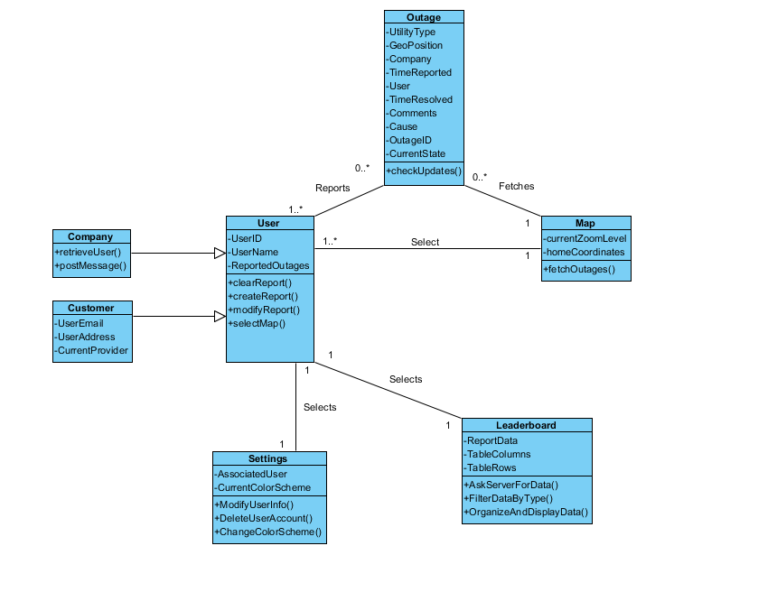
Class Diagram

Slide 6
Sequence Diagrams

Slide 7
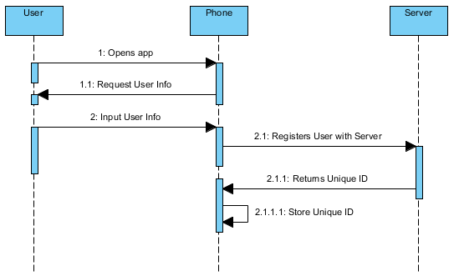
Initial Load

Slide 8
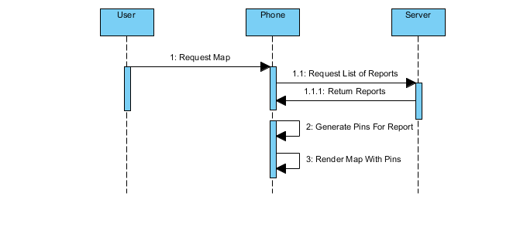
Load Map

Slide 9
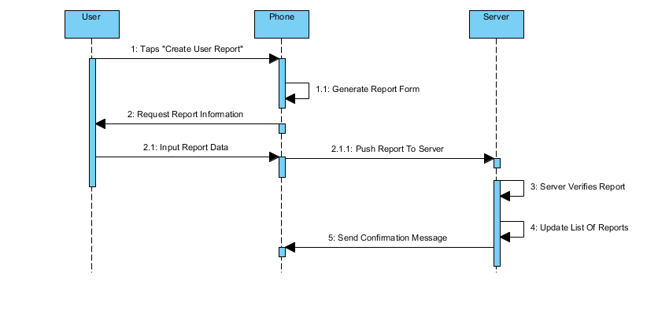
Send Report

Slide 10
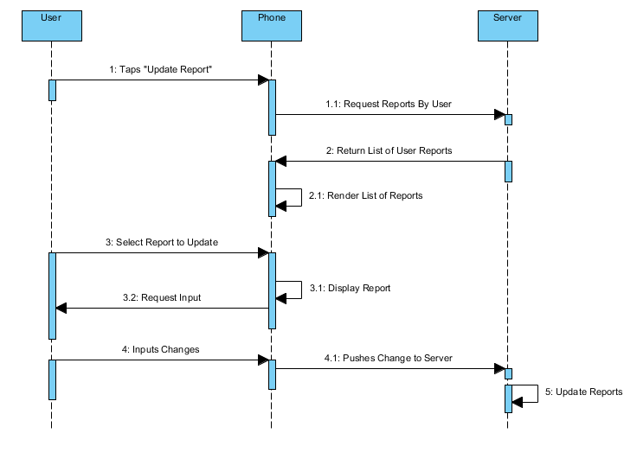
Update Report

Slide 11
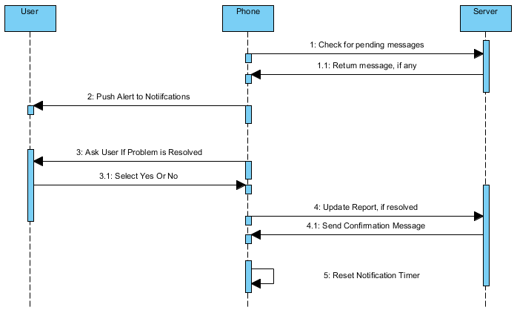
Ask User For Outage Status

Slide 12
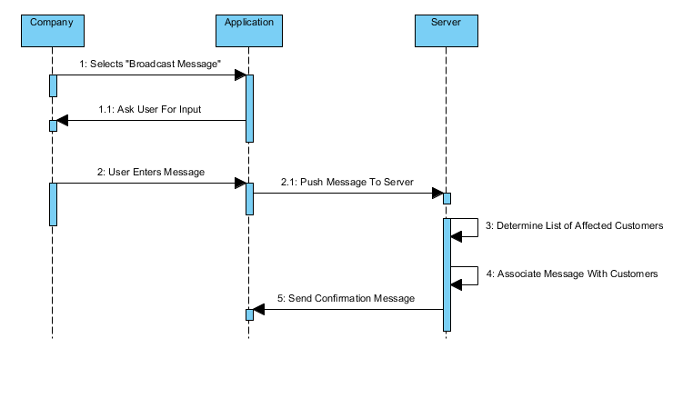
Broadcast Message

Slide 13
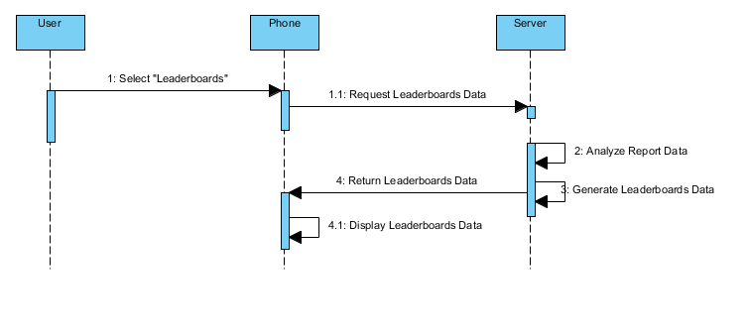
Leaderboard

Slide 14
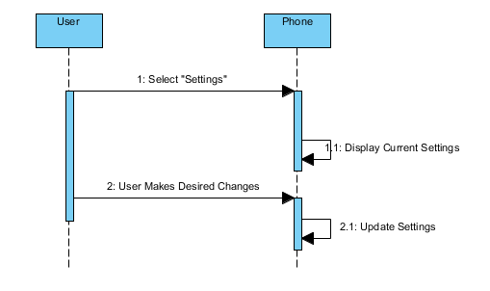
Settings

Slide 15
Changes from Requirements
Modularized more of the function
Added customization as a priority (color schemes)
Upgraded stat tracking (leaderboards) to priority
Map is no longer the entirety of the app with optional views attached to it (eg. weather radar app). List of reports style approach is now the plan with ancillary map (i.e. twitter with a heat map)
Analytics more of a focus

